Slide 1
The Role of Cities in Economic Development
and the case for subnational finance
Navaid Qureshi – August 2018
navaid.qureshi@gmail.com

Slide 2
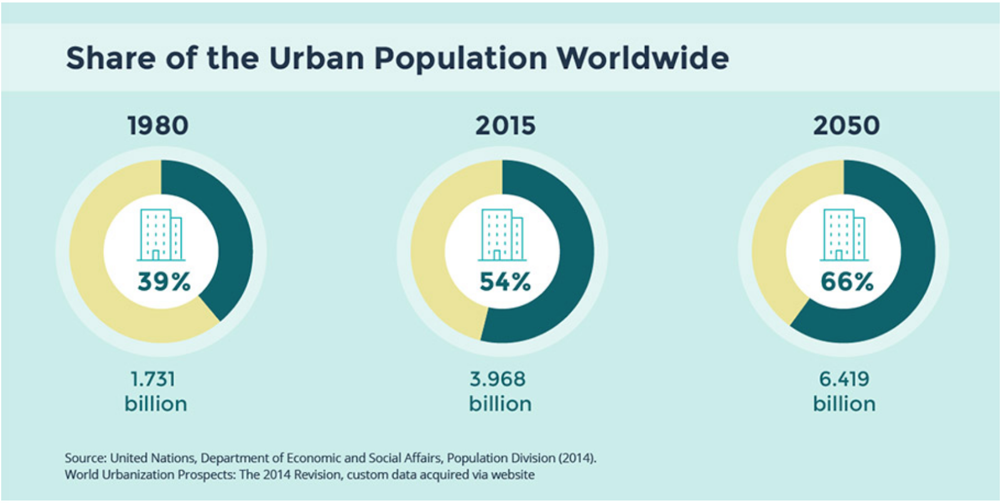
Global Urbanization Trends

Slide 3
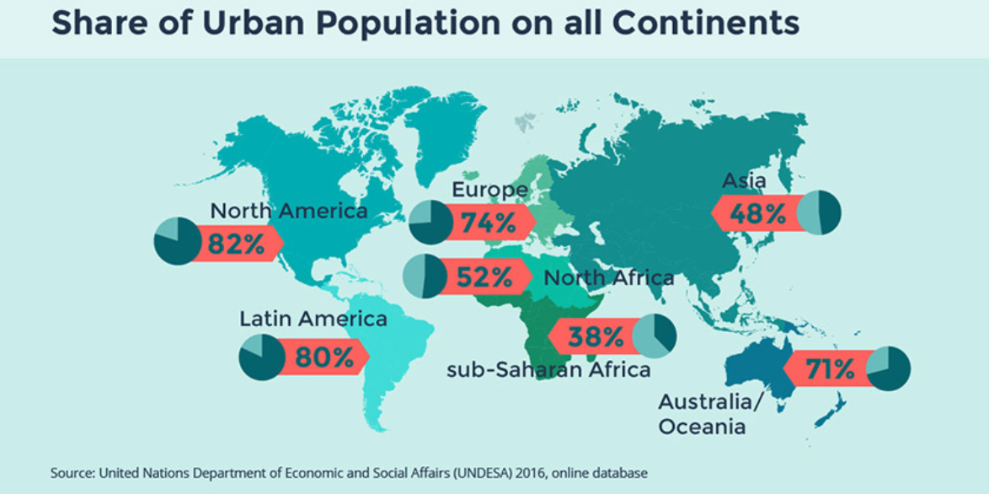
Urban Population by Region

Slide 4
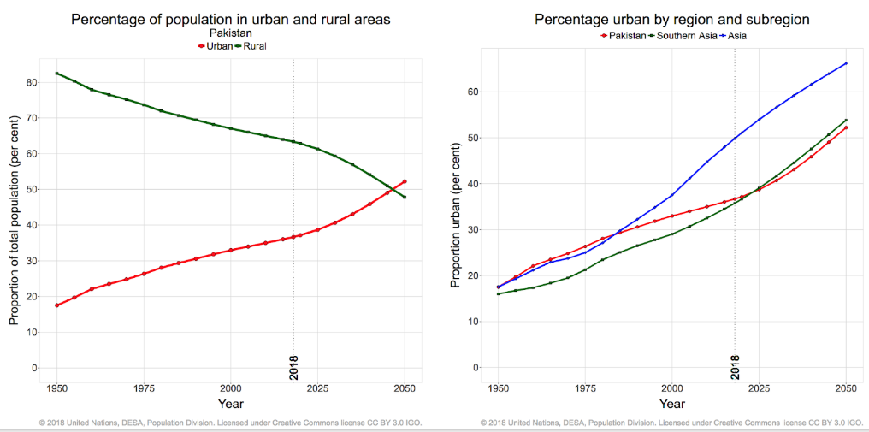
Urbanization Trends in South Asia

Slide 5
Why Cities Exist?
… because households are not self-sufficient;
Surplus food cultivation in rural areas → allows people to move off land → Enables labor specialization and large-scale production lowering costs) → trade → higher standard of living
Historical Evolution: Trading Cities, Factory Cities, Specialized Cities, Metropolitan Cities.
Density … defining feature of cities.
Benefits of urbanization economies → sharing intermediate inputs, labor pools, skill matching, knowledge spillovers. Better employment opportunities learning environment for workers, social opportunities. (but also more congestion, noise, pollution)
Agglomeration effects : a doubling of population increases output per worker by 3-8%,

Slide 6
A Framework for Well-Functioning Cities
Cities are Engines of Economic Growth.
They need to be:
Livable
Competitive
Bankable
Well managed

Slide 7
Levers of Economic Productivity
and increasing per-capita income
Deepening Physical Capital (machines, equipment, infrastructure)
Increasing Human Capital (knowledge, skills)
Technological Progress and Innovation
Cites need to provide
efficient and well - functioning land and labor markets;
a supportive business environment;
access to finance

Slide 8
Karachi – Economic Significance
Metropolitan population: 16-20 million people (22-28% of urban population)
Contributes 11-20% of GDP; Per-capita GDP is 1.4 x national average
5.7% GDP growth per annum during 2000-12, compared to 4.5% nationally
Provides 5.5% of domestic employment; growing at 5.1% per annum
Worker productivity is 2x national average (2012)
High contributor to national tax revenue
Declining population in poverty: 9% (in 2014-15), down from 23% in (2004-05)
63% of employment in manufacturing and trade;
finance and real estate sector emerging as key growth driver (13% of GVA)

Slide 9
Karachi – Snapshot of Challenges 1
Real per capita GDP growth relatively low (2.7% per annum)
Anemic labor productivity growth (0.47% per annum < half the national rate)
stagnating economic activity in the central areas of the City
declining competitiveness – losing manufacturing activity to Punjab
employment growth in relatively low-productivity jobs;
large and growing informality in employment (67% in 2011)
low female participation rate in urban labor force (8.5% in Sindh compared to 14% in Punjab and KP).

Slide 10
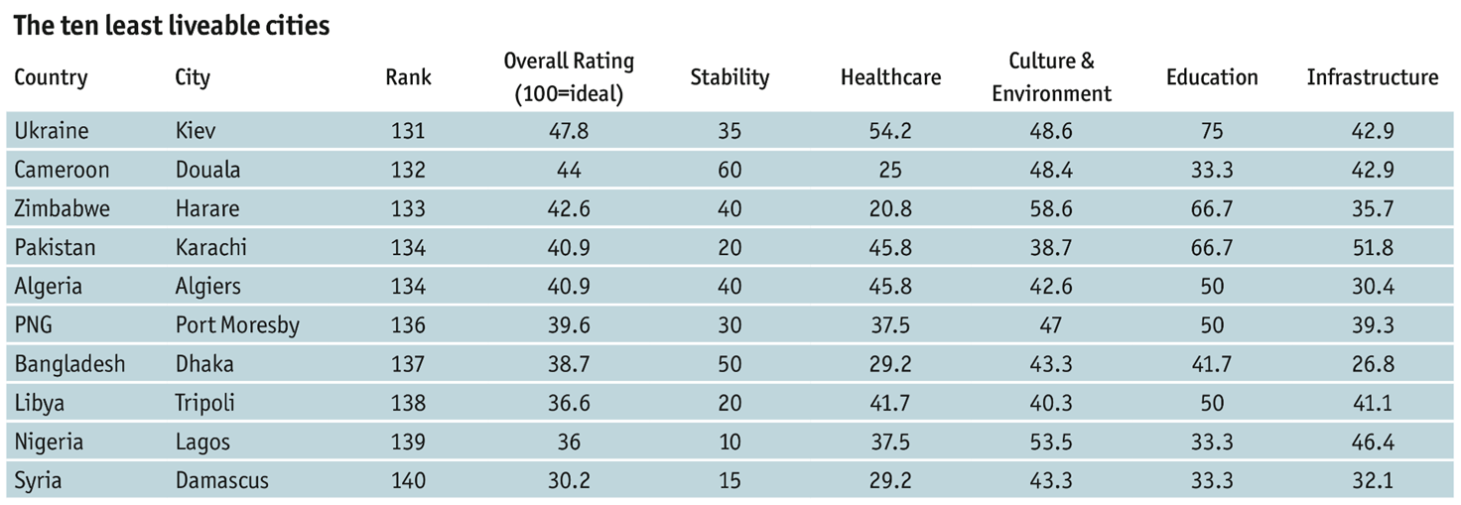
One of the least livable major cities in the world ranked 134 out of 140 in EIU Global Livability Index

Slide 11
Karachi – Snapshot of Challenges 2
Large and growing infrastructure gap
~50% live in informal settlements
No mass transit system; Public transport shortage (seats 1:40 vs 1:11 in Mumbai)
Only one third of solid waste collected (4000 MT of 12000 MT)
Dysfunctional land markets
Violence and criminal activity
Urban segregation and social exclusion

Slide 12
Karachi – Snapshot of Challenges 3
Private sector investment to GDP halved in 2015
factors cited:
Corruption (35% respondents, compared to 9% for S. Asia)
Political Instability
Power shortages
Poor regulation of businesses

Slide 13
Underlying Causes
City Government exists at pleasure of provincial government (no constitutional protection for 3rd tier)
Weak City Leadership; limited authority
Lack of Vision, consistent development strategy
Fragmented Institutions for Service Delivery (20 transportation agencies) – with low capacity; poor coordination
Insufficient Financial Resources – exclusive reliance on budgetary transfers; capital grants from higher tiers

Slide 14
Key Aspects of Thriving EM Cities
Metropolitan Governance – Empowered, Accountable and Responsive local government; Coordination across institutions; Professional capacity and technical competence
Fiscal Decentralization – matching fiscal resources with responsibilities (transfers + own source revenue)
Subnational Finance - Creditworthy LG entities, able to leverage a robust and secure revenue base, to access commercial borrowing
Private Sector Participation - user ability to pay and credible track record of contract enforcement; counterparty financial standing; enabling legal, regulatory, institutional framework; counterpart capacity

Slide 15
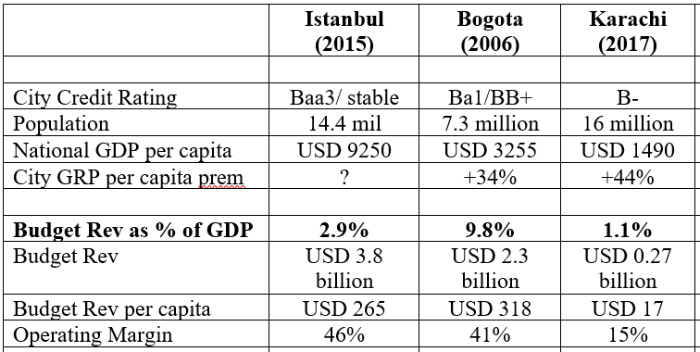

Slide 16
References
Transforming Karachi into a Livable and Competitive Megacity – A City Diagnostic and Transformation Strategy (World Bank)
The Global Livability Report 2017 (EIU)
Speaker’s operational notes

